Slide 1

Introduction to algorithms
Seminar 9
w/c:29 November 2021

Slide 2
Minimal balanced BST from a list
L=[1,2,3,4,5,6,7,8,0,2.5,8.5,9,10]
L=[0,1,2,2.5,3,4,5,6,7,8,8.5,9,10]
Sorted list!!

Slide 3
Minimal balanced BST from a sorted list
L=[0,1,2,2.5,3,4,5,6,7,8,8.5,9,10]
5

Slide 4
Minimal balanced BST from a sorted list
L=[0,1,2,2.5,3,4,5,6,7,8,8.5,9,10]
5
2
8.5

Slide 5
Minimal balanced BST from a sorted list
L=[0,1,2,2.5,3,4,5,6,7,8,8.5,9,10]
5
2
8.5
3
7

Slide 6
Minimal balanced BST from a sorted list
L=[0,1,2,2.5,3,4,5,6,7,8,8.5,9,10]
5
2
8.5
1
3
7
9

Slide 7
Minimal balanced BST from a sorted list
L=[0,1,2,2.5,3,4,5,6,7,8,8.5,9,10]
5
2
8.5
1
3
7
9
4
6

Slide 8
Minimal balanced BST from a sorted list
L=[0,1,2,2.5,3,4,5,6,7,8,8.5,9,10]
5
2
8.5
1
3
7
9
2.5
4
6
8

Slide 9
Minimal balanced BST from a sorted list
L=[0,1,2,2.5,3,4,5,6,7,8,8.5,9,10]
5
2
8.5
1
3
7
9
0
2.5
4
6
8
10
depth = 4

Slide 10
Deleting a node from bst
Delete node value 8.5; keeping balanced minimal BST
5
5
2
8.5
2
8
1
2.5
8
9
1
2.5
7
9
0
3
7
10
0
3
6
10
4
6
4

Slide 11
inserting a new node onto a bst
Insert node value 2.3; keeping balanced minimal BST
5
5
2
8
2.3
8
1
2.5
7
9
2
2.5
7
9
0
3
6
10
1
3
6
10
4
0
4

Slide 12
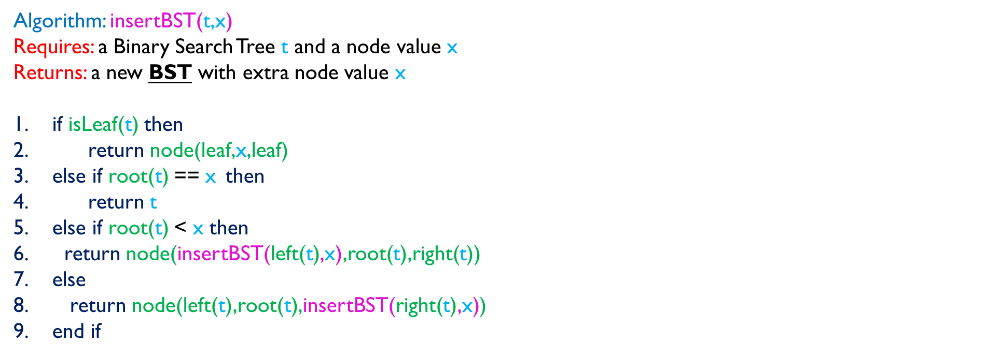
Insert algorithm – insertBST(t,x)
Question:
Algorithm: insertBST(t,x)
Requires: a Binary Search Tree t and a node value x
Returns: a new BST with extra node value x
if isLeaf(t) then
return node(leaf,x,leaf)
else if root(t) == x then
return t
else if root(t) < x then
return node(insertBST(left(t),x),root(t),right(t))
else
return node(left(t),root(t),insertBST(right(t),x))
end if
Which of the insertion algorithms is faster?
Sorted Lists OR BST?

Slide 13
Binary search tree traversal
9
Preorder (NLR):
[9,6,2,1,3,12,10,15,14,16]
6
12
Postorder (LRN):
[1,3,2,6,10,14,16,15,12,9]
Inorder (LNR):
[1,2,3,6,9,10,12,14,15,16]
2
10
15
1
3
14
16

Slide 14
Write an algorithm for inorder traversal of a bst
Algorithm: inOrder(t)
Requires: a Binary Search Tree t
Returns: a sorted list of BST’s node values
TWO OPTIONS:
Obtain node values in
any order (e.g. Breadth first) and
put in a list; then apply merge-sort.
2. Obtain node values in
the right order (e.g. LNR) and
put in smaller sorted lists; then apply merge OR concLists (from CW3).

Slide 15
Option 1
Algorithm: inOrder(t)
Requires: a Binary Search Tree t
Returns: a sorted list of BST’s node values
if isLeaf(t) then
return Nil
else
Let L=cons(root(t),concLists(inOrder(left(t)),inOrder(right(t))))
return mergeSort(L)
endif

Slide 16
Option 1 – trace!!
6
12
9
L=cons(9,concLists(inOrder( ),inOrder( )))
2
7
6
12
.
.
.
.
2
7
L=cons(9, concLists(cons(6, concLists(cons(2,Nil),cons(7,Nil)),cons(12,Nil)))
L=cons(9, concLists( [6,2,7],[12] ))
= [9,6,2,7,12]
if isLeaf(t) then
return Nil
else
Let L=cons(root(t),concLists(inOrder(left(t)),inOrder(right(t))))
return mergeSort(L)
endif
mergeSort( [9,6,2,7,12] )
= [2,6,7,9,12]

Slide 17
Option ii – the actual inOrder (LNR)
Algorithm: LNR(t)
Requires: a Binary Search Tree t
Returns: a sorted list of BST’s node values
if isLeaf(t) then
return Nil
else
return merge(LNR(left(t)),merge(cons(root(t),Nil),LNR(right(t))))
endif

Slide 18
LNR trace!!
9
6
12
merge(LNR( ),merge(cons(9,Nil),LNR( )))
6
12
2
7
2
7
merge(merge([ ],merge([2],[ ]),merge([6],merge([ ],merge([7],[ ])))),merge([9],merge([ ],merge([12], [ ]))))
merge([2,6,7], [9,12])
= [2,6,7, 9,12]
if isLeaf(t) then
return Nil
else
return merge(LNR(left(t)),merge(cons(root(t),Nil),LNR(right(t))))
endif

